Slide 1


Slide 2



Slide 3
Team Leader : Yousef Mosad Team Members: 1-Gehaad Magdi 2- Dina Mahmoud 3- yahya Khaled 4- Silvia Hany

Slide 4
Today, we will discuss a crucial topic in the world of technology and financial management—Oracle Systems. These systems are among the most powerful solutions for managing data and business operations in organizations. Our focus will be on Oracle ERP, a comprehensive enterprise resource planning system, along with Oracle Fixed Assets, a key module for efficient asset management.
🔹 Oracle is a global leader in providing advanced database solutions and cloud services, helping businesses enhance performance and analyze data more intelligently. 🔹 Oracle ERP (Enterprise Resource Planning) is an integrated system for managing various financial and administrative operations, such as accounting, inventory management, supply chains, and human resources. It enhances efficiency and supports informed decision-making. 🔹 Oracle Fixed Assets is a critical module within Oracle ERP that helps organizations manage and track fixed assets like equipment and properties. It improves financial accuracy, automates depreciation calculations, and simplifies financial reporting.
In this presentation, we will explore how these systems enable businesses to achieve greater financial and operational efficiency. Let’s get started!

Slide 5
Gehaad Magdi
2. Setup Fixed Assets:
Flex Field Assets|
Category
Locations
Asset Key
System Control
Fiscal Years
Calendar
Prorate Convention
Book Control
Assets Categories
Create New:
Fixed Assets Responsibility
Profile Options

Slide 6
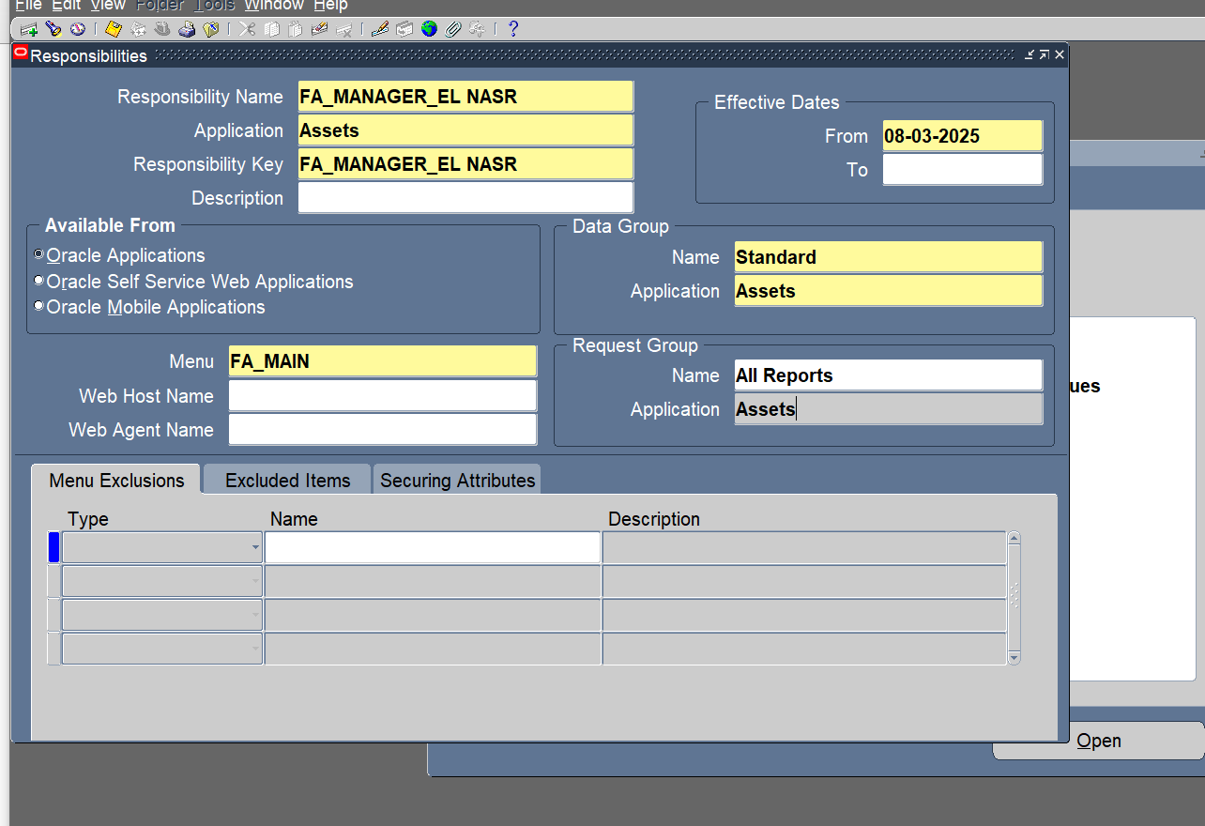
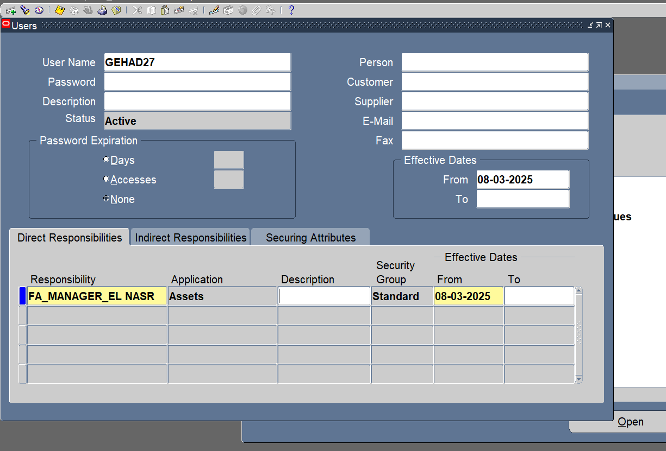
Create New Fixed Assets Responsibility:
System Administrator > Security > Responsibility > Define
Security > User > Define

Slide 7
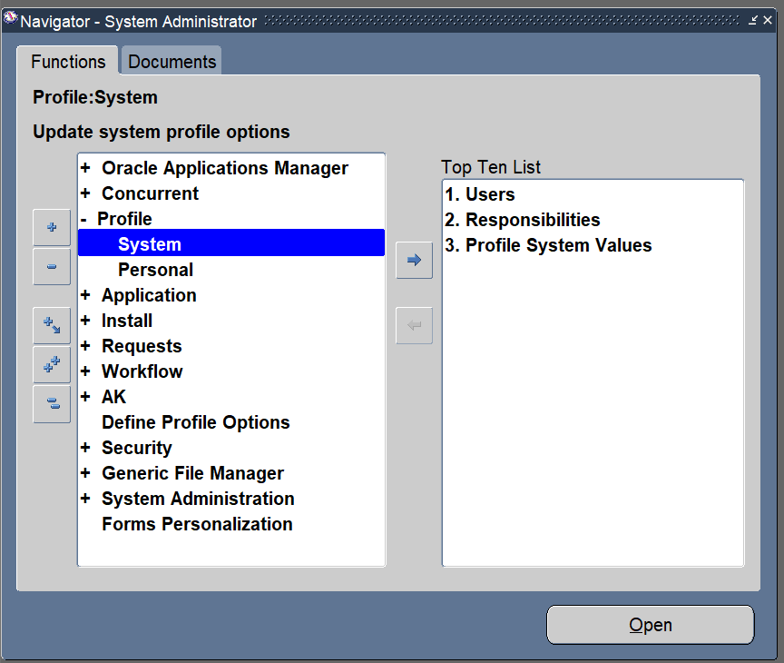
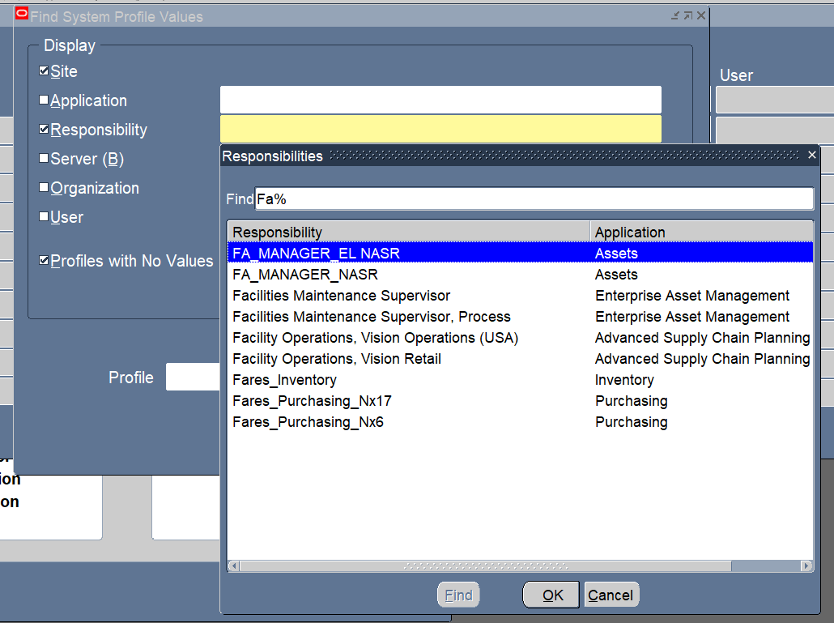
Create New Profile Options:
System Administrator > Profile > System

Slide 8
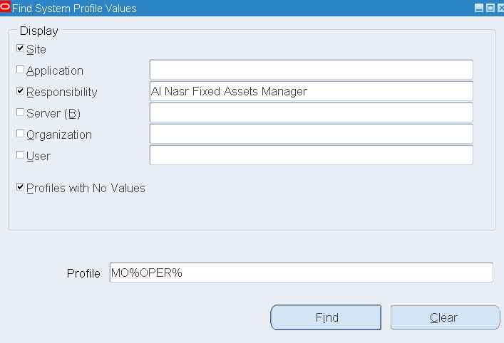
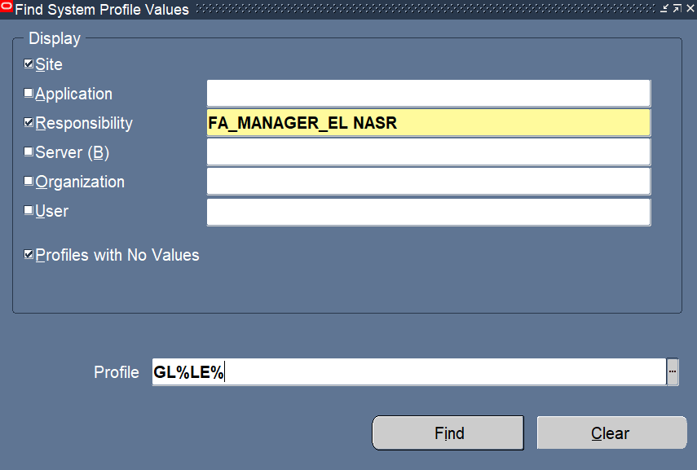
نختار علي مستوي responsibility

Slide 9
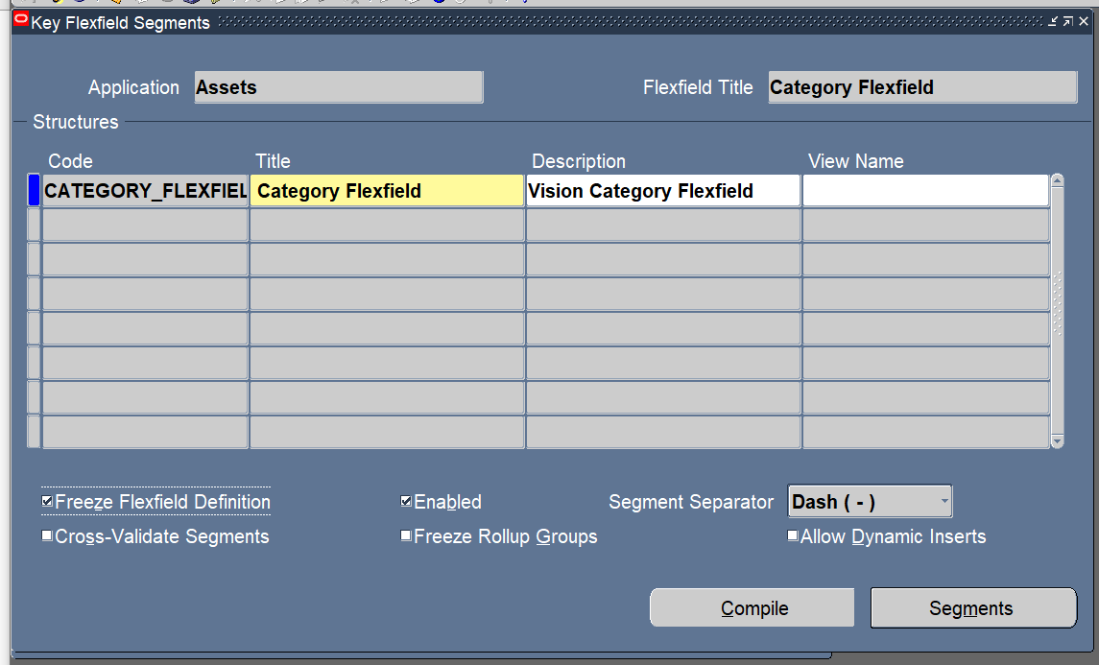
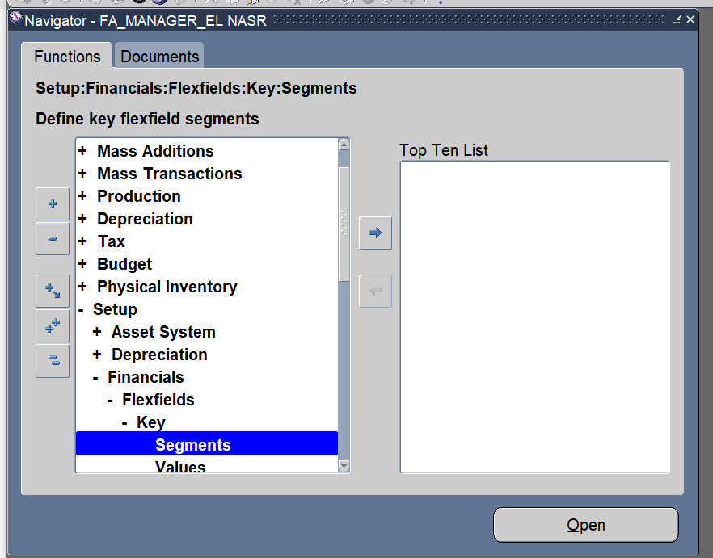
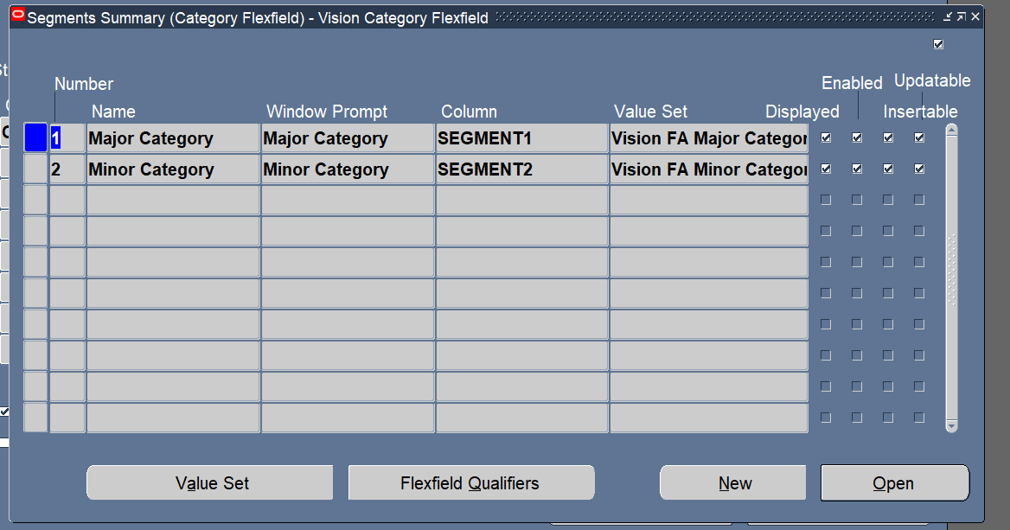
Setup Flex Field Assets|
Category
Setup > Financial > Flex field > Segments

Slide 10
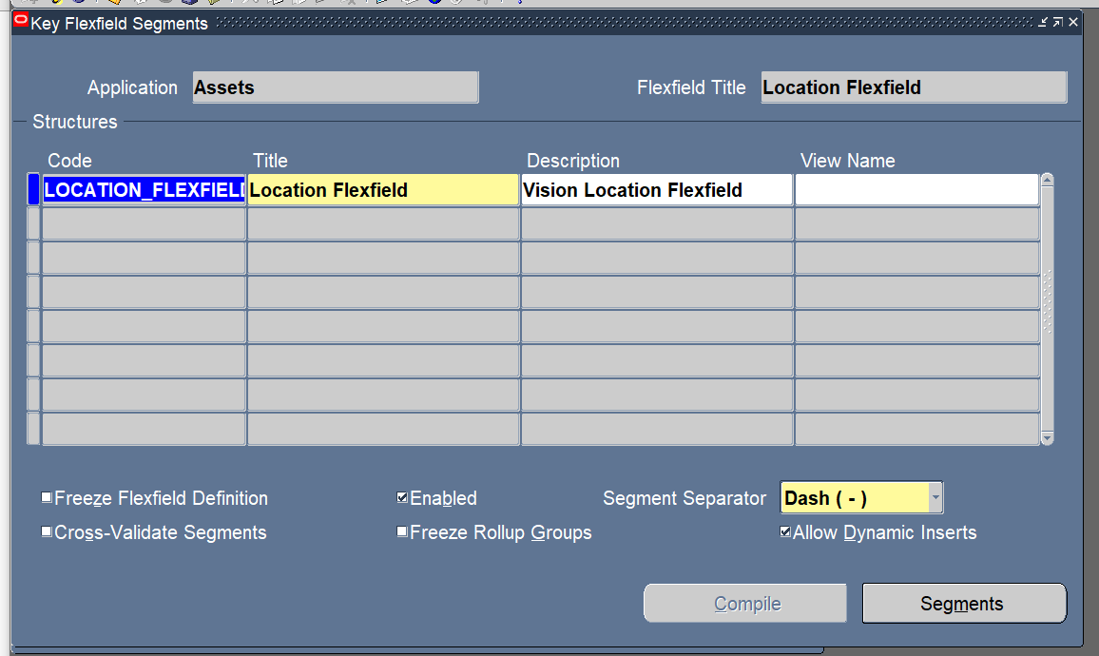
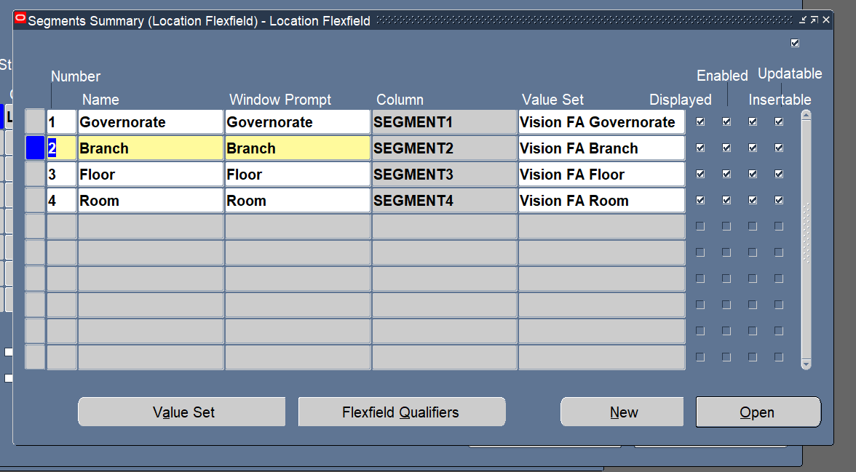
Locations
Setup > Financial > Flex field > Segments

Slide 11
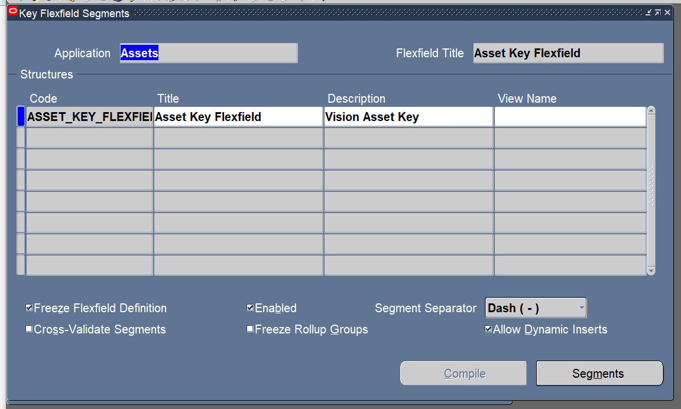
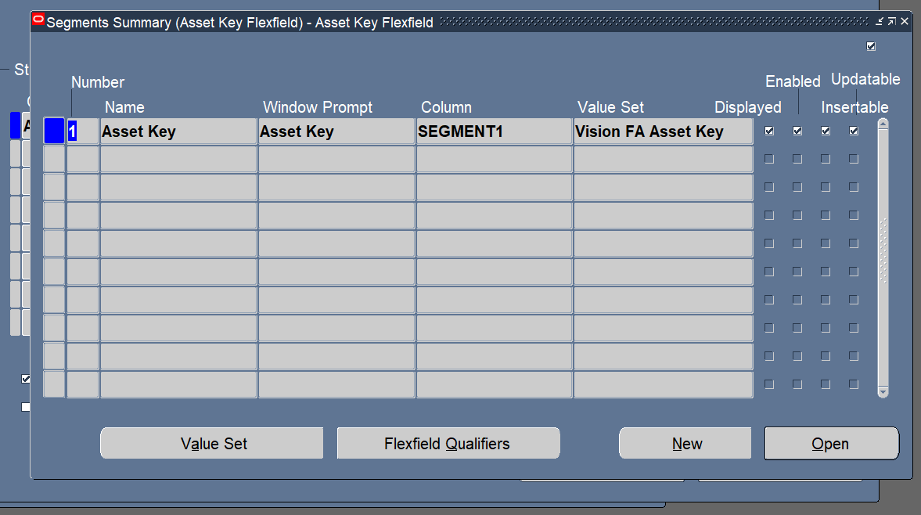
Asset Key
Setup > Financial > Flex field > Segments

Slide 12
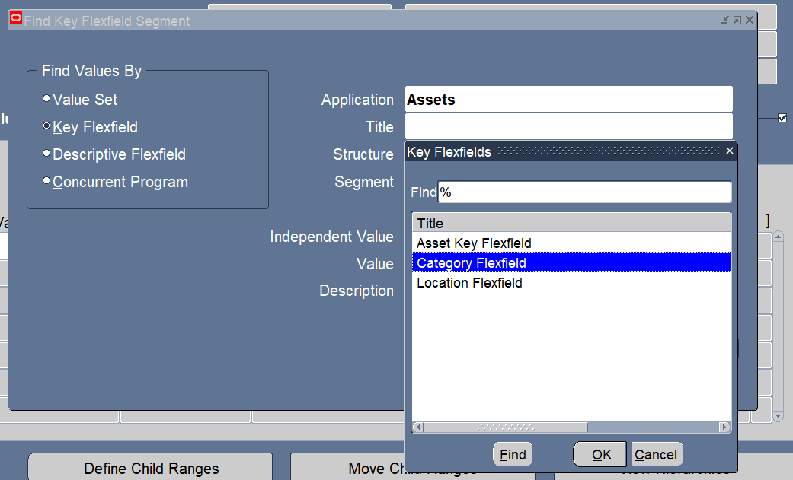
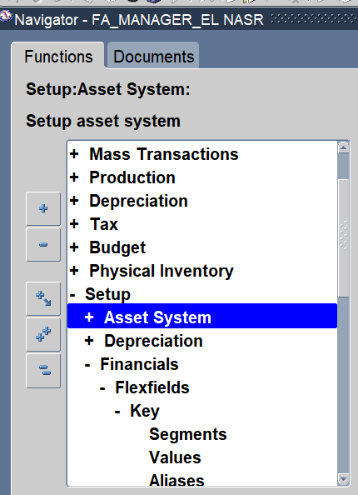
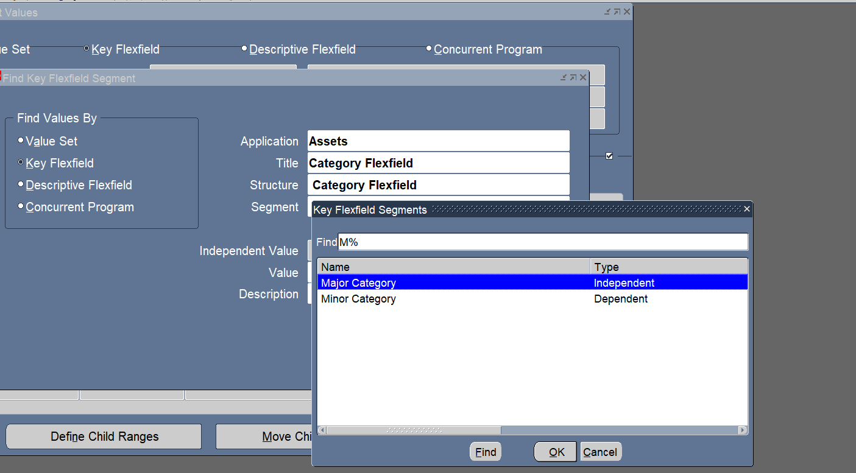
Value Set
Financial > Flex field > key > value

Slide 13
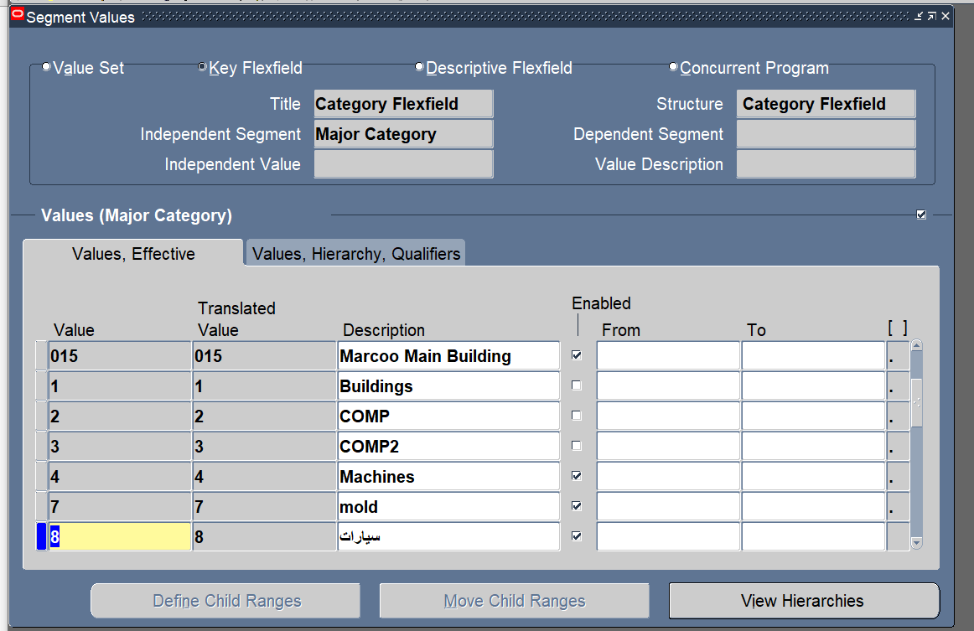
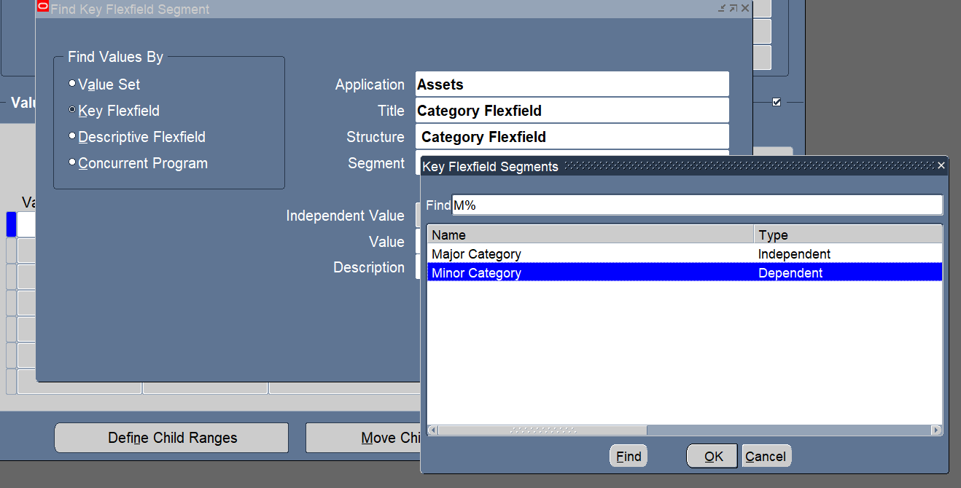
نختار major

Slide 14
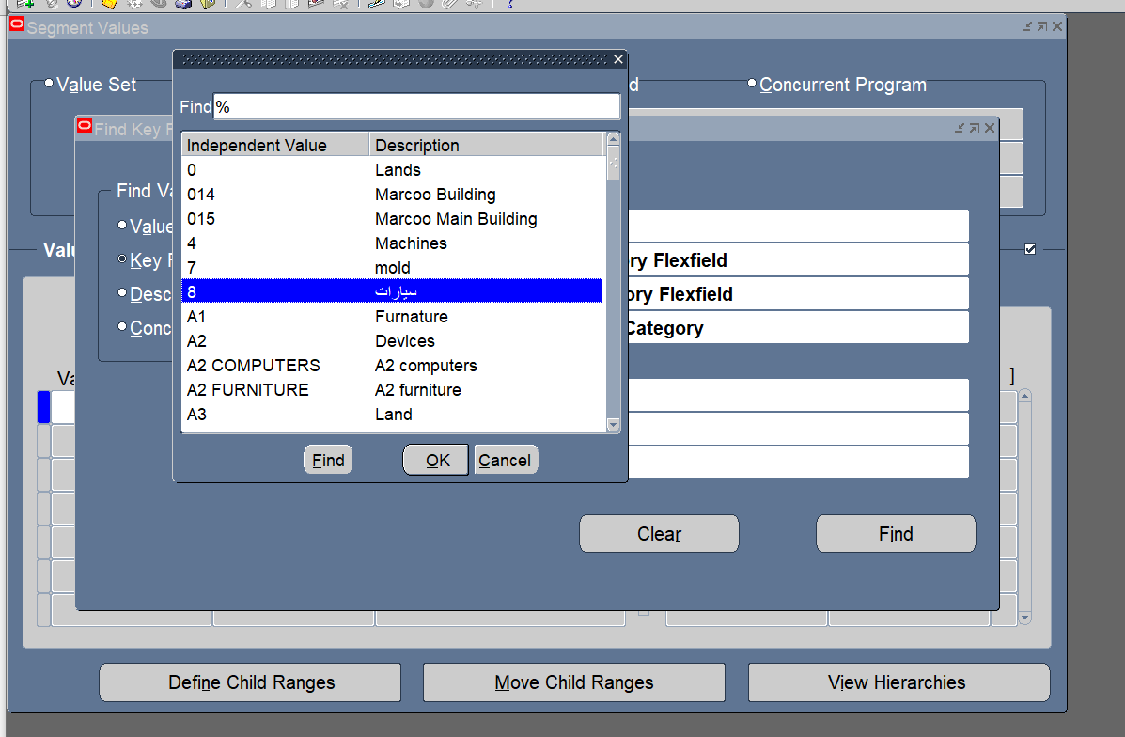
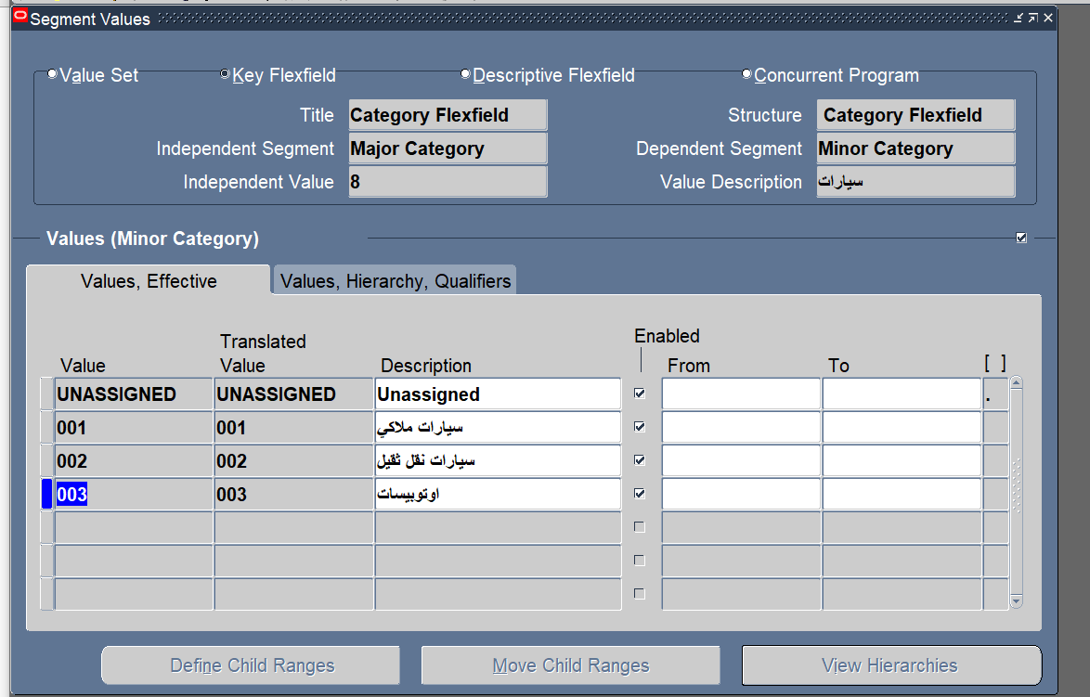
بعد كدا نختار minor

Slide 15
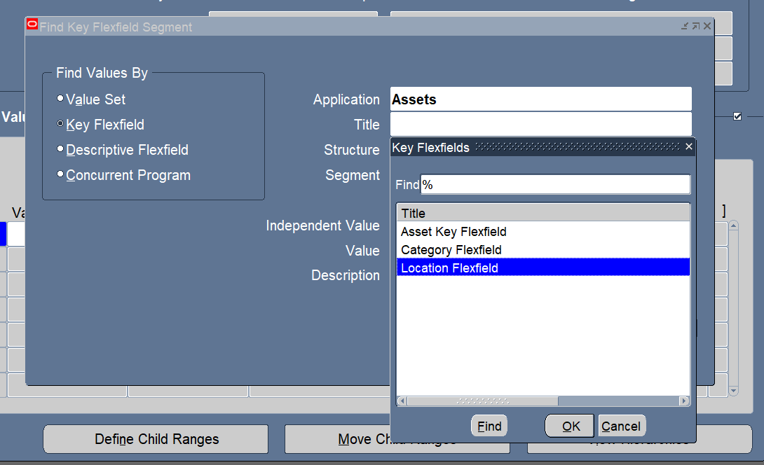
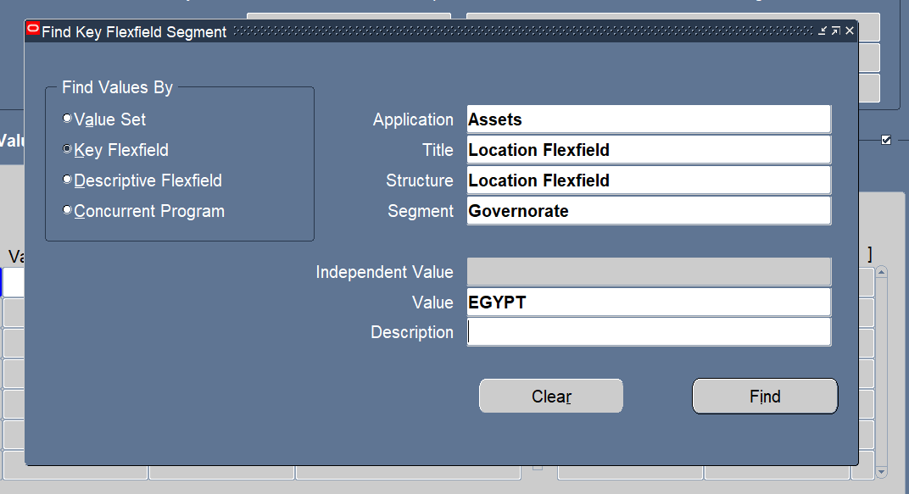
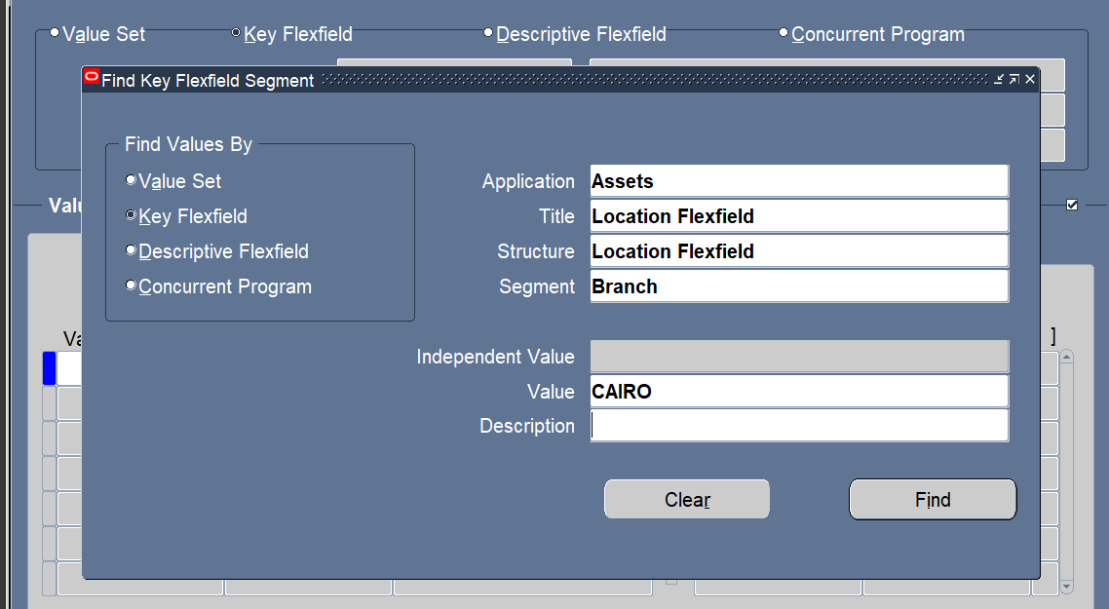
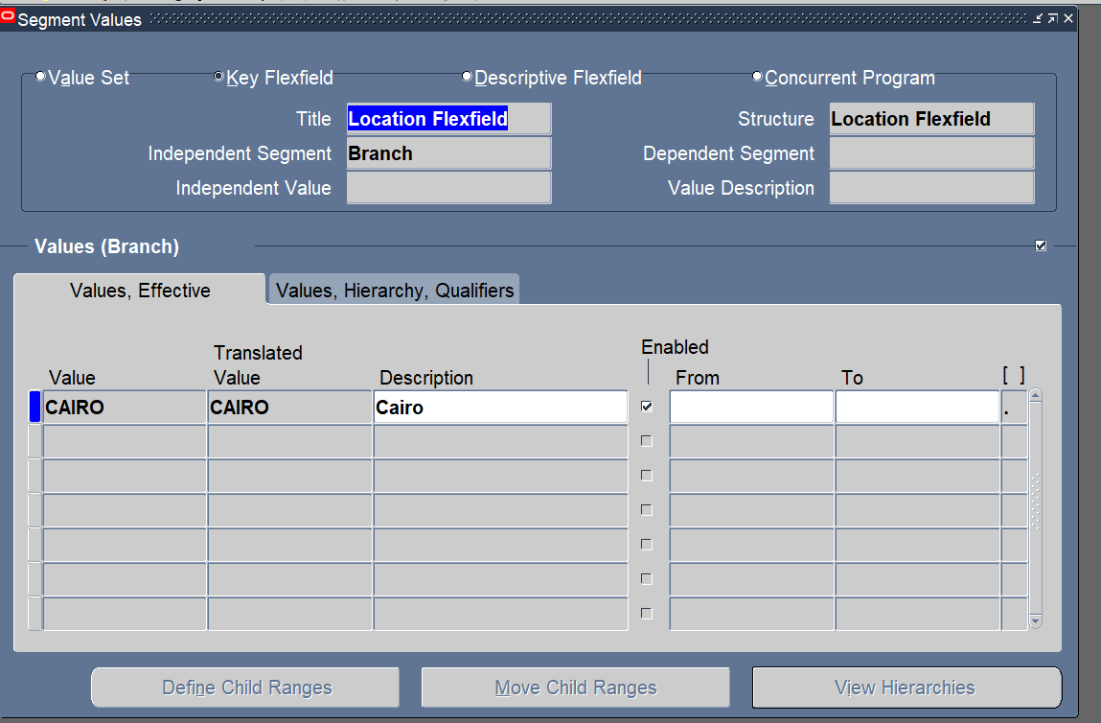

Slide 16
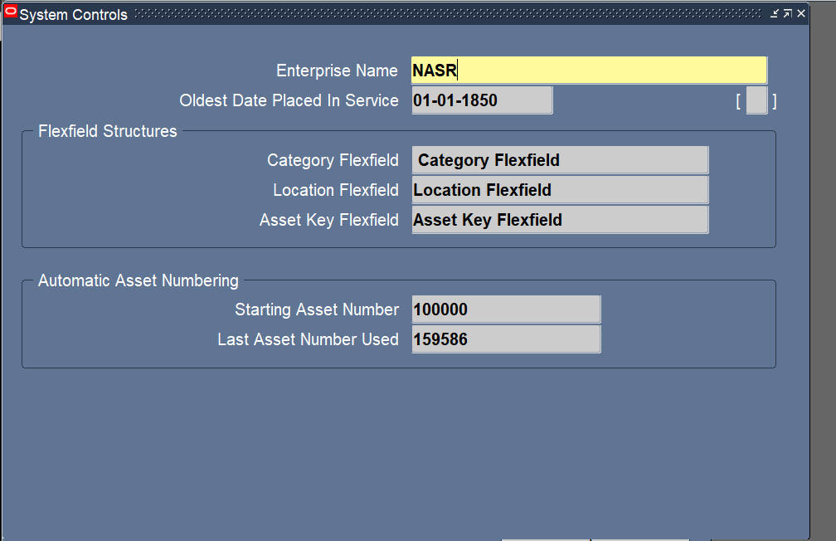
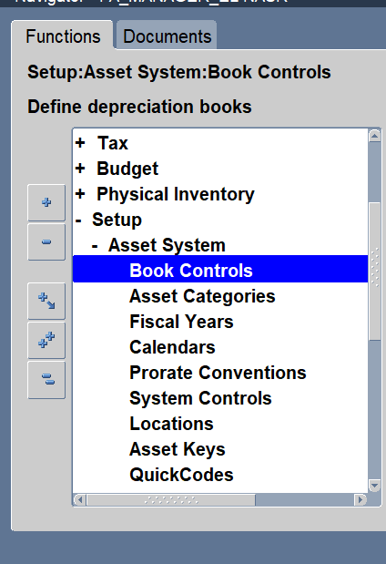
Setup System Control
Setup > Asset System > System Control

Slide 17
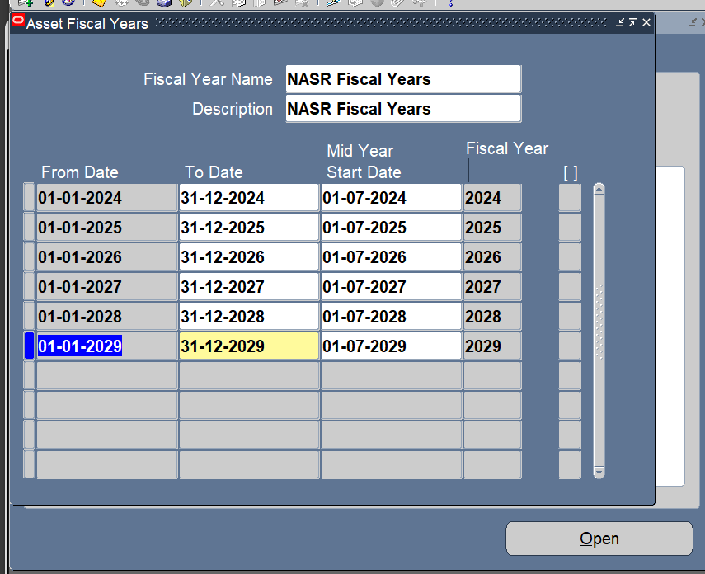
Setup Fiscal Years
Setup > Asset system > Fiscal Year

Slide 18
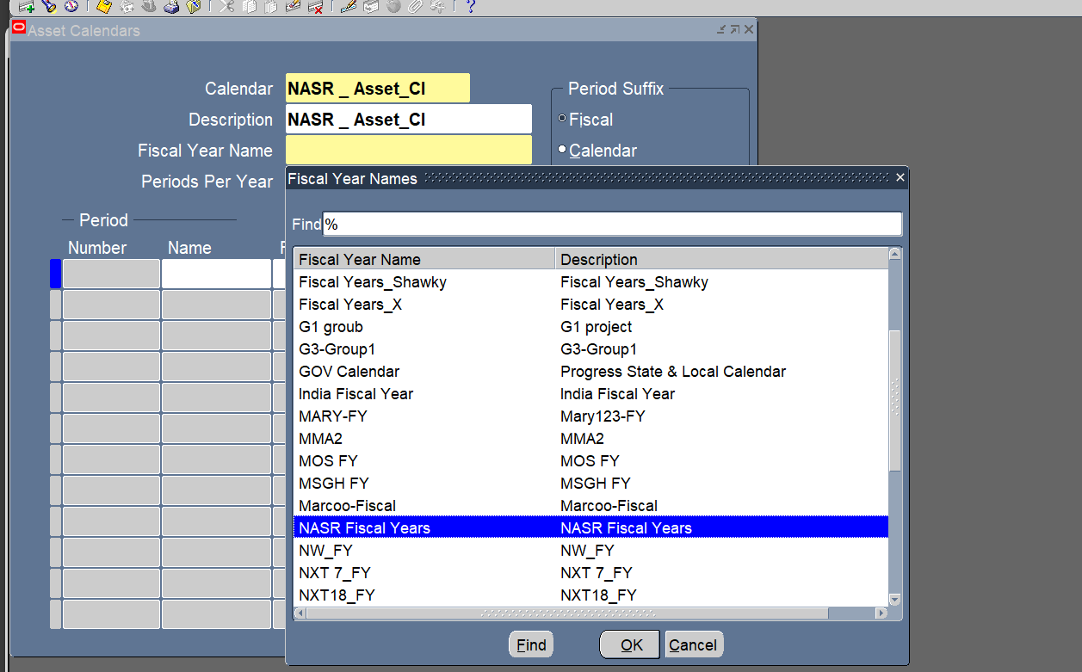
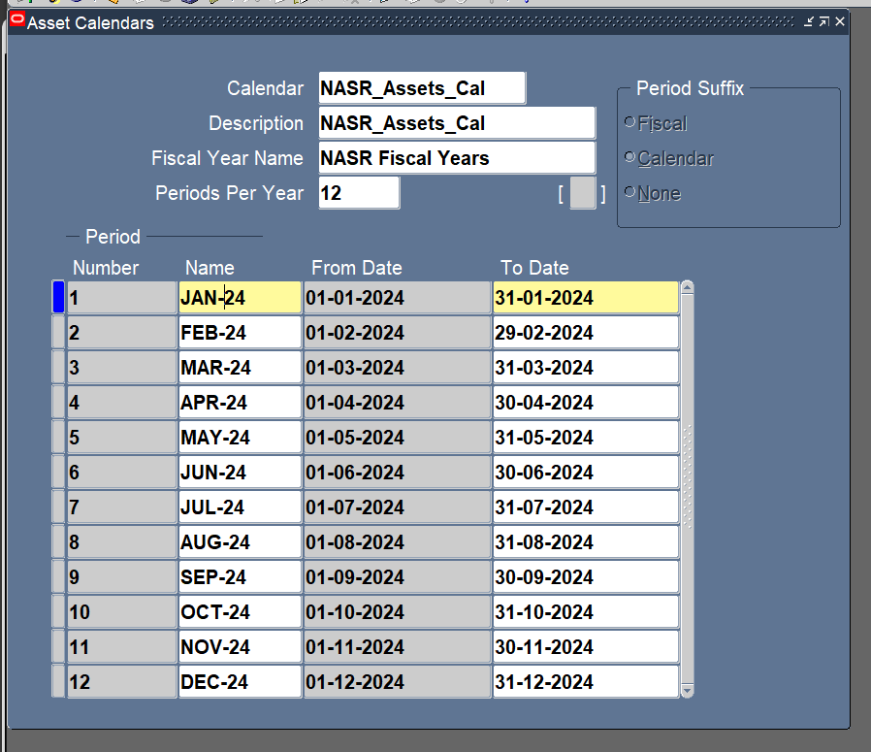
Setup Calendar
Setup > Asset System > Calendar

Slide 19
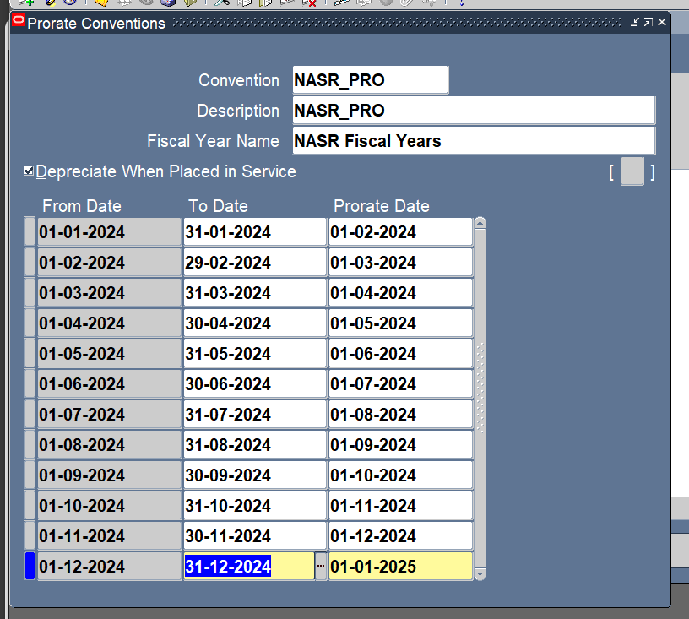
Setup Prorate Convention
Setup > Asset System > Prorate Convention

Slide 20
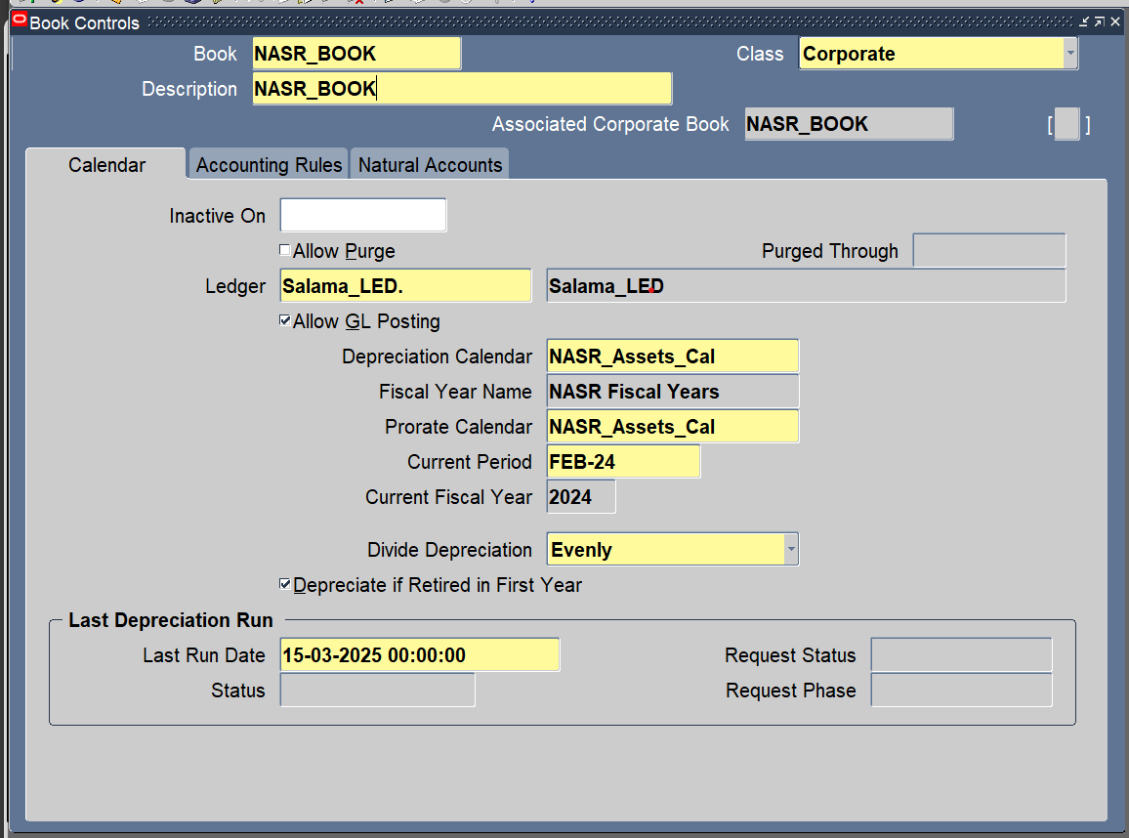
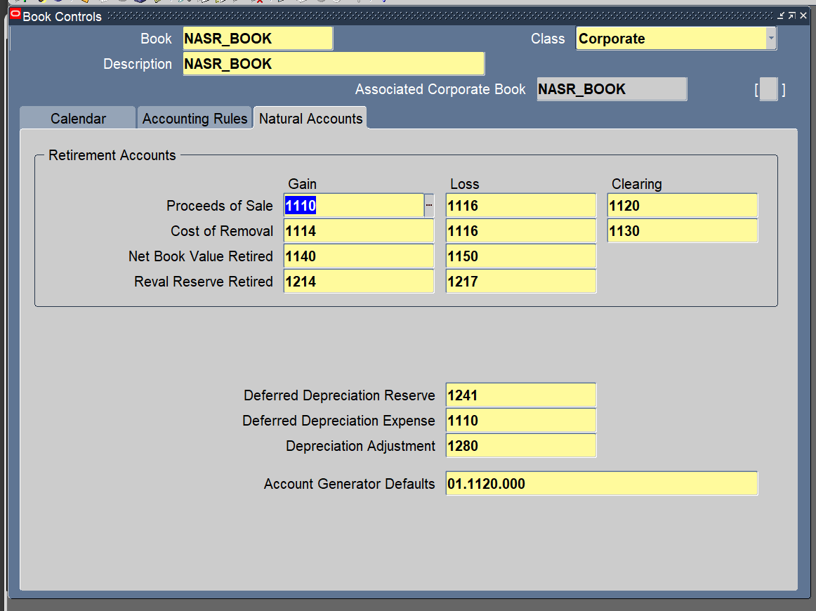
Setup Book Control
Setup > Asset System > Book Controls

Slide 21
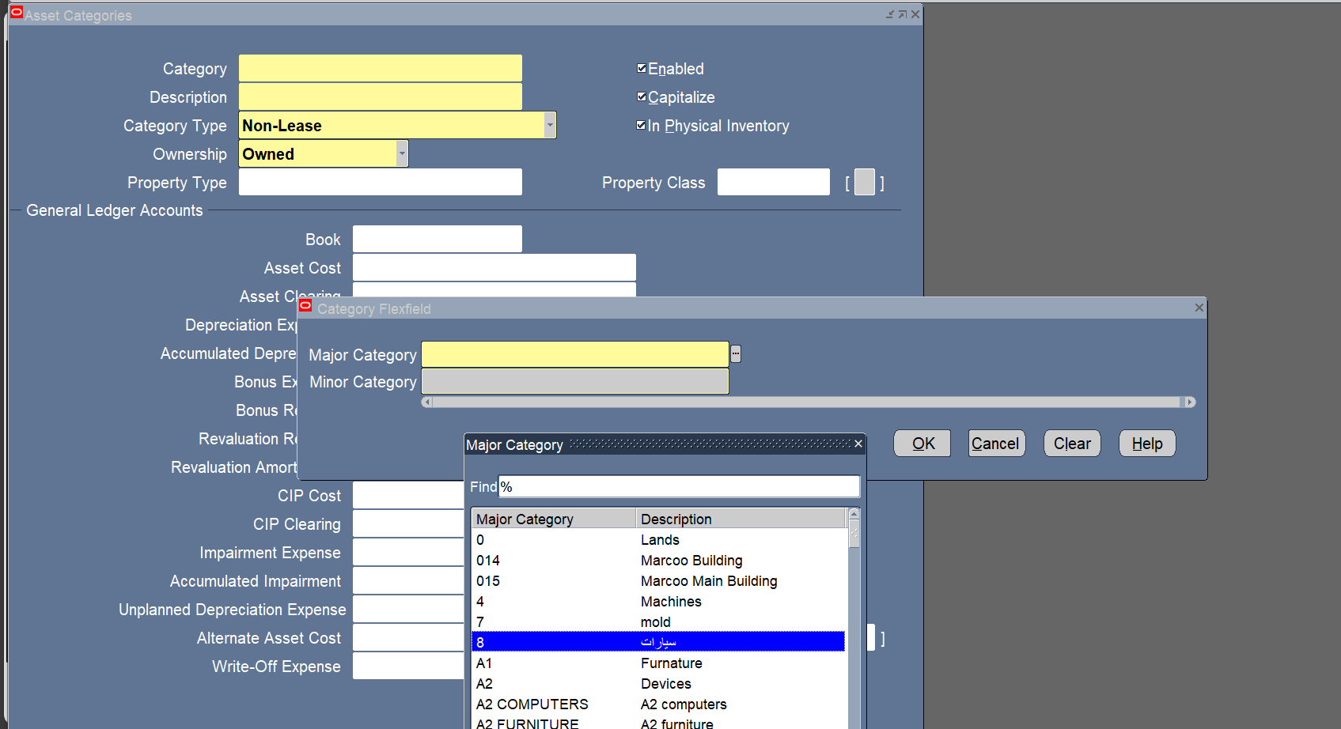
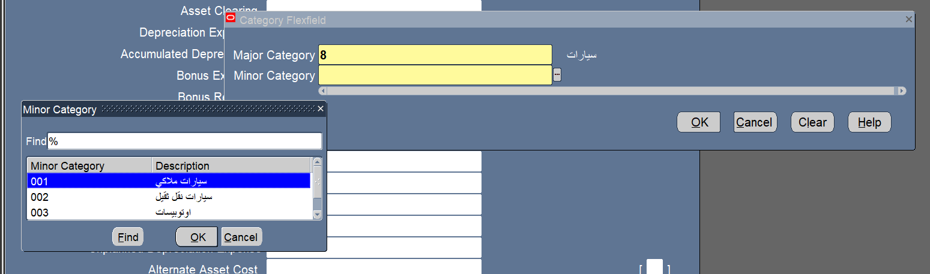
Setup Assets Categories
Setup > Asset System > Asset Categories

Slide 22
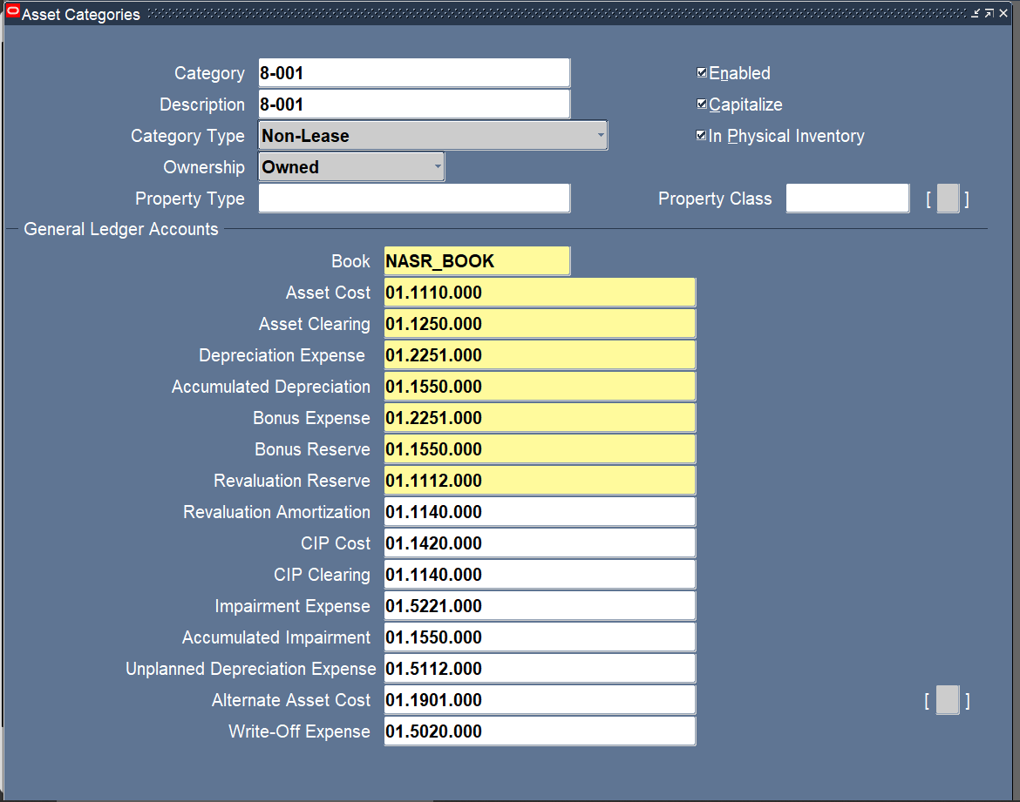
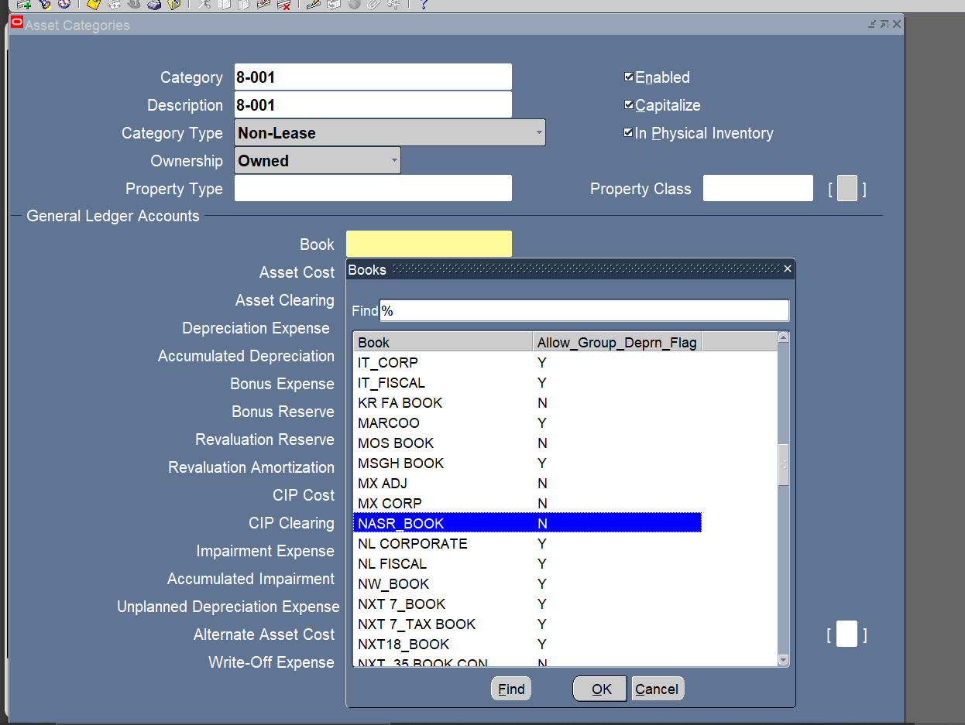
General Ledger Accounts

Slide 23
Name:Dina Mahmoud Ramadan
3-Manual Asset Adition.
4-Quick Addition.

Slide 24
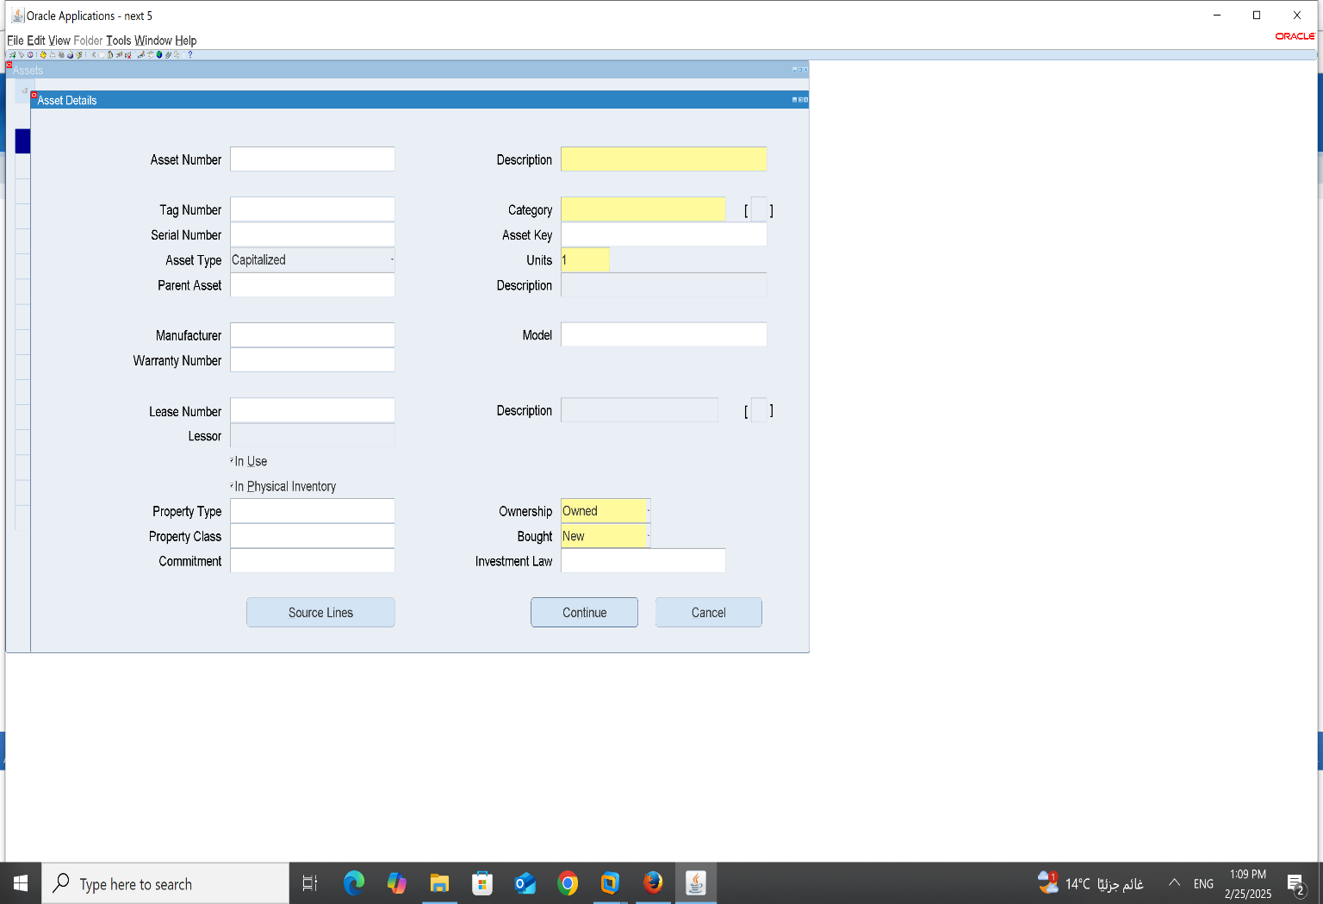
3-Manual Asset Adition:
ASSET_ASSET WORKBENCH_ADDITION

Slide 25

Then We should fill the blancks 1-Description:

Slide 26
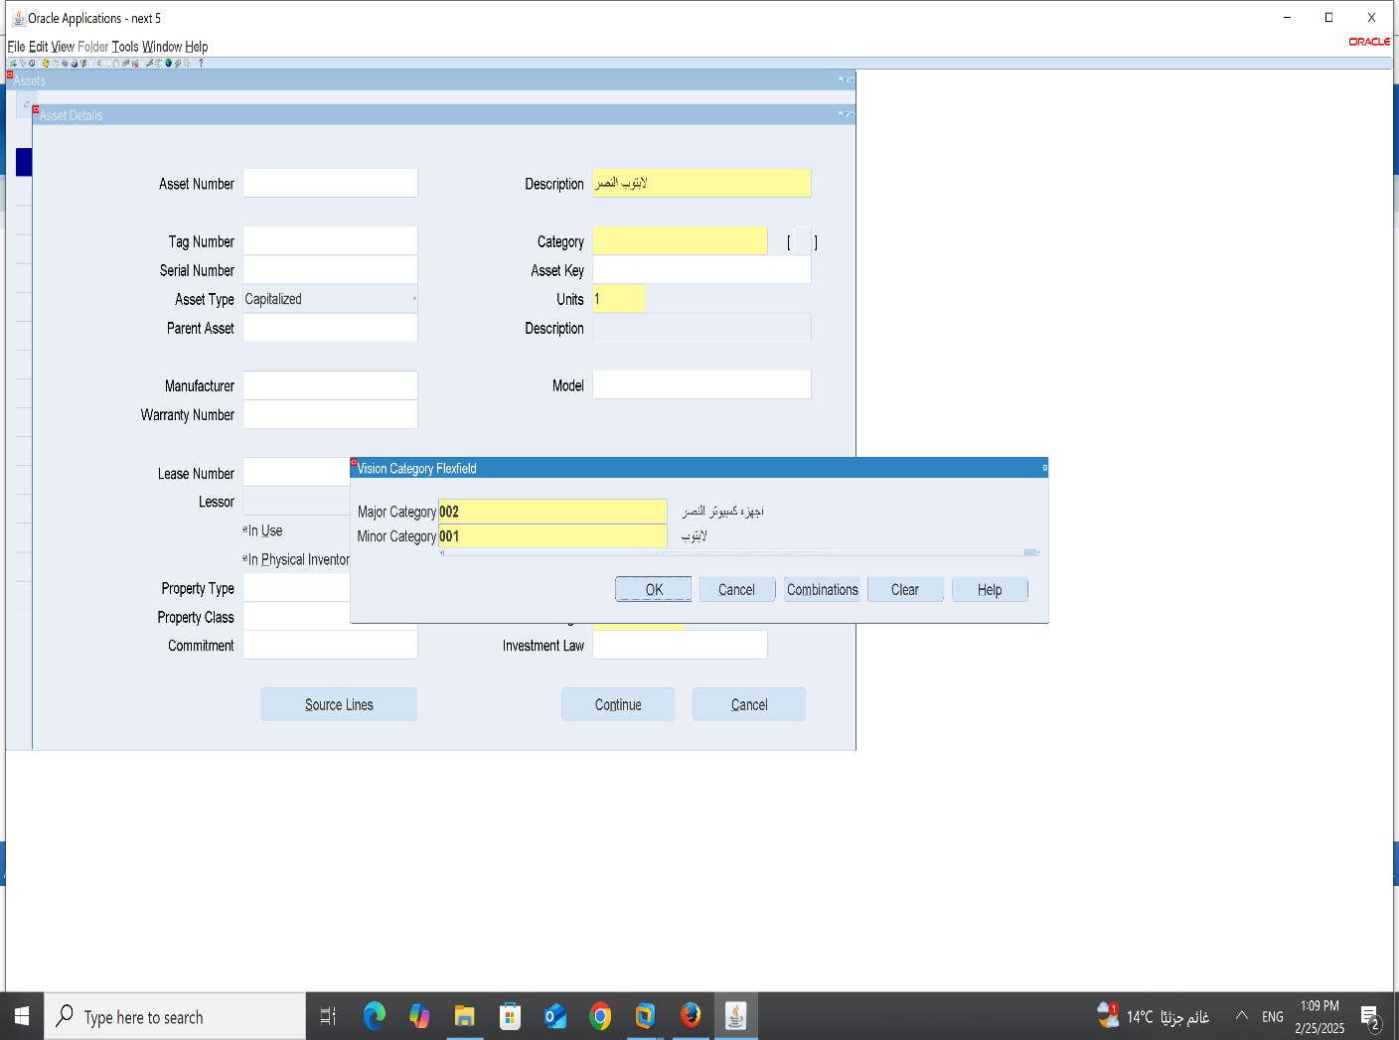
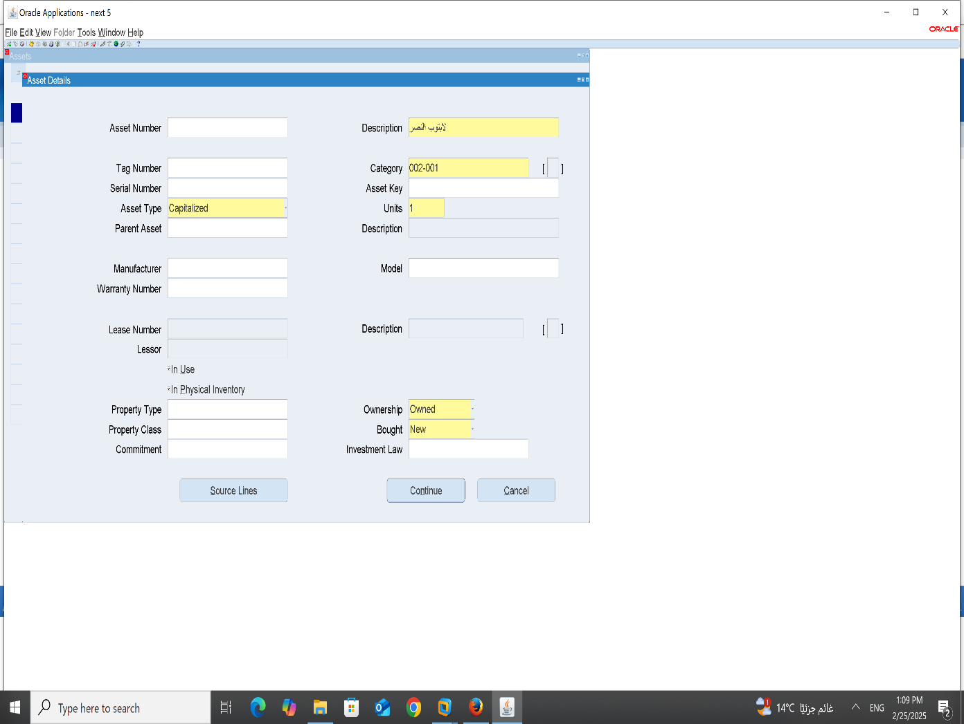
2-Category: A-major: B-minor:

Slide 27

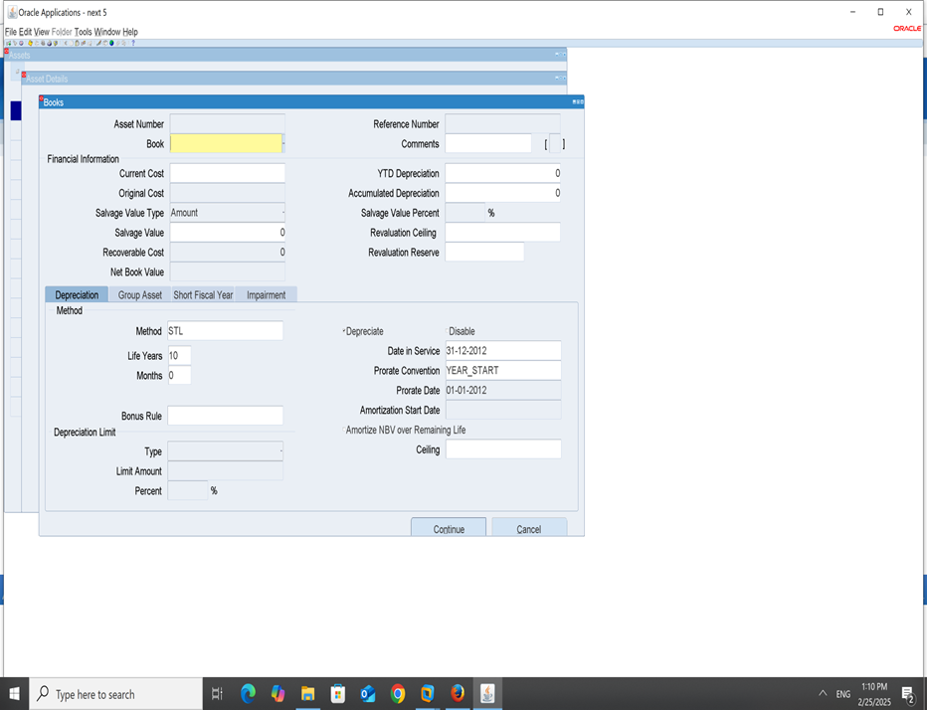
3-Asset key: 4-Units: 5-Then press countinue:

Slide 28
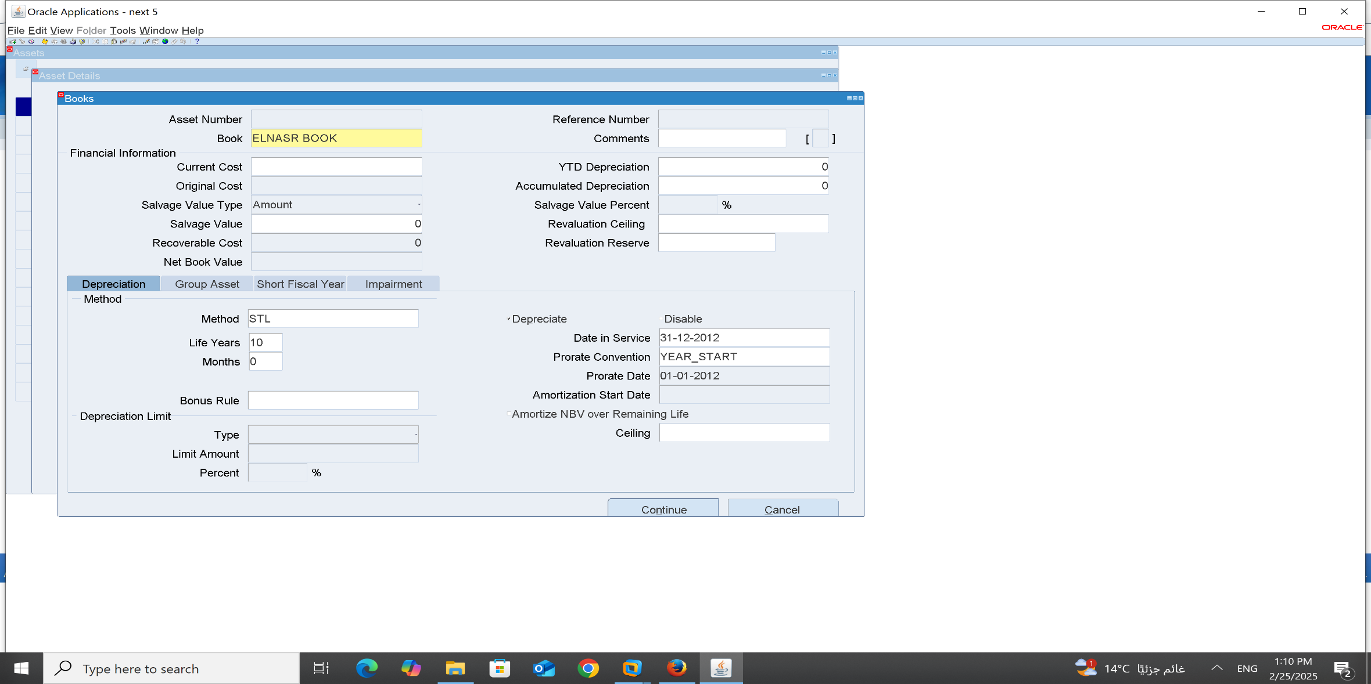
6-Book:

Slide 29
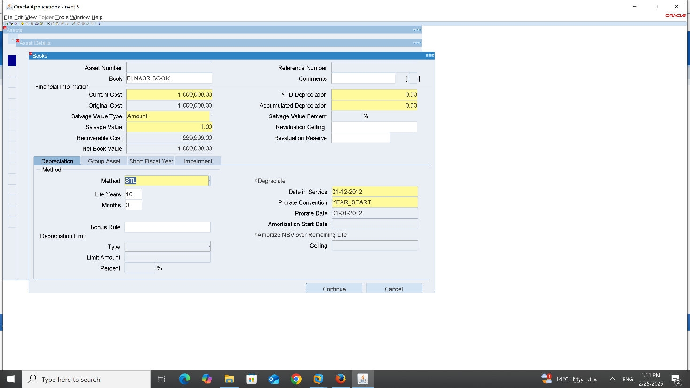
7-current Cost 8-Salvage value 9-Method –Life years-Months 10-Date in service-prorate convention-prorate date 11-press countinue

Slide 30
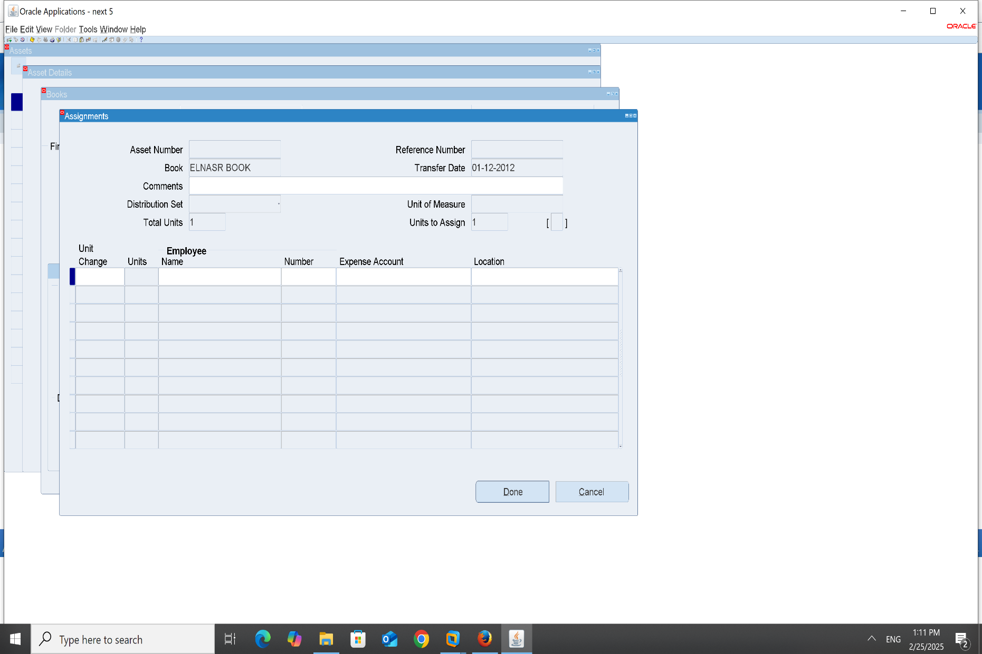
12-Book:

Slide 31
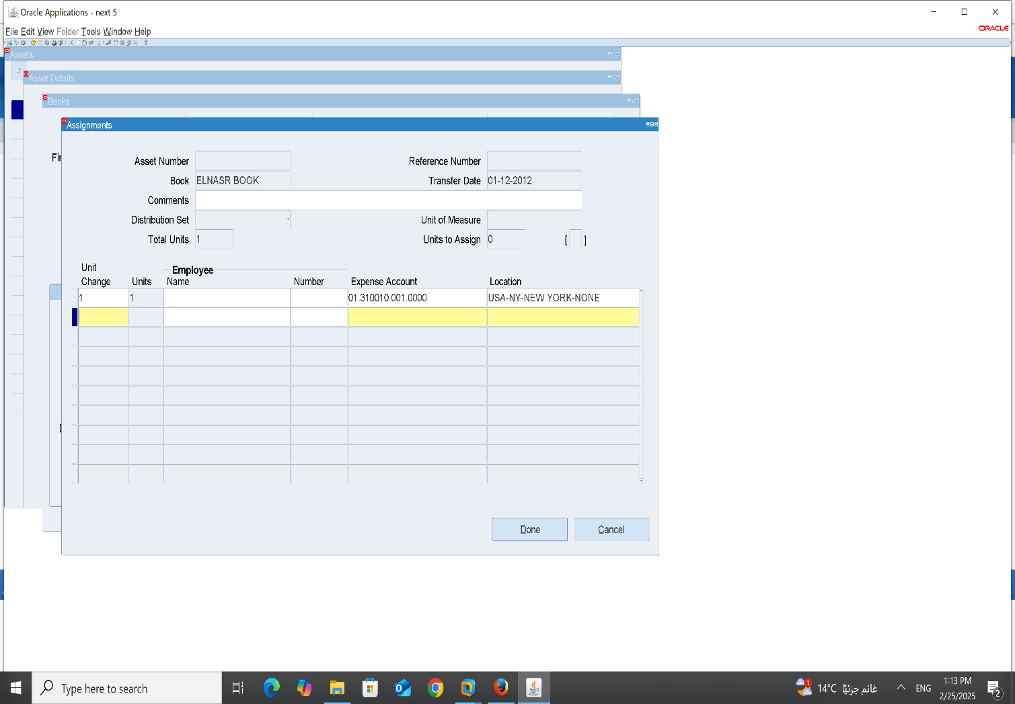
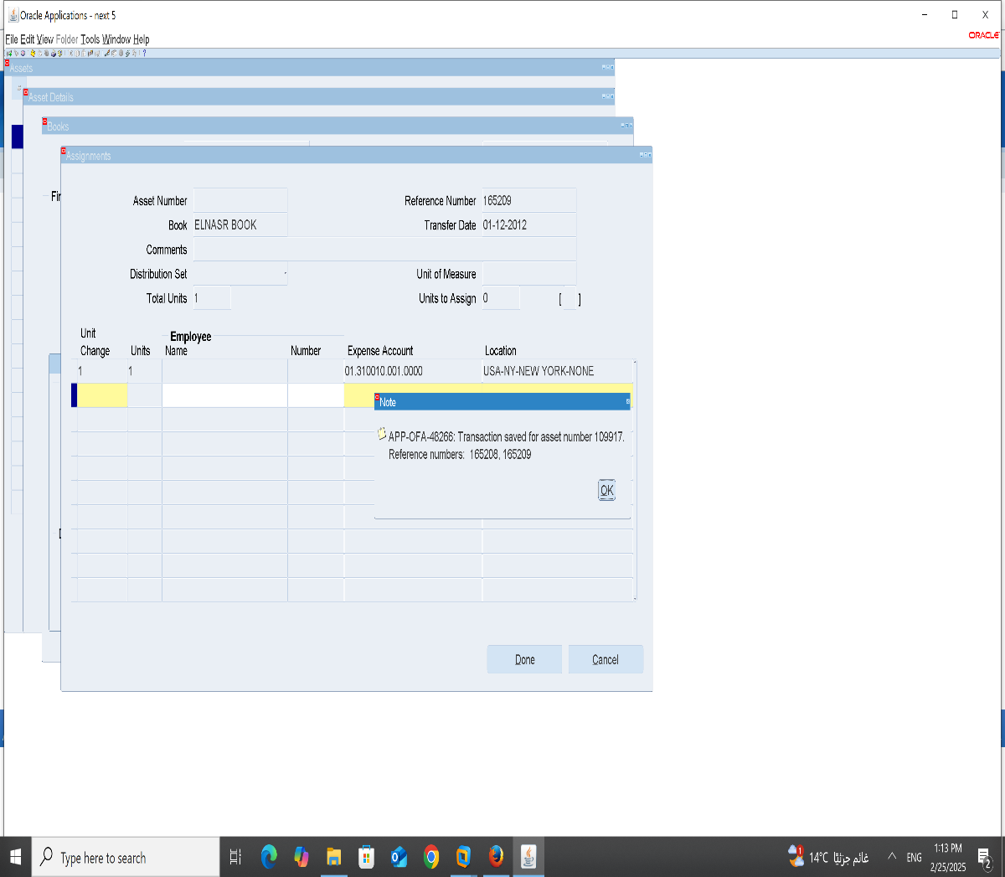
13- Unit Change –Expense Account-Location: 14-press Done

Slide 32
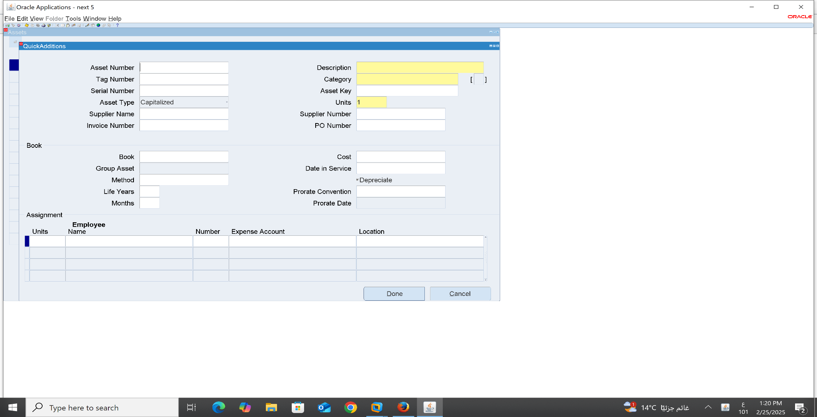
4-Quick Addition: Asset-Asset workbench-Quick Addition

Slide 33
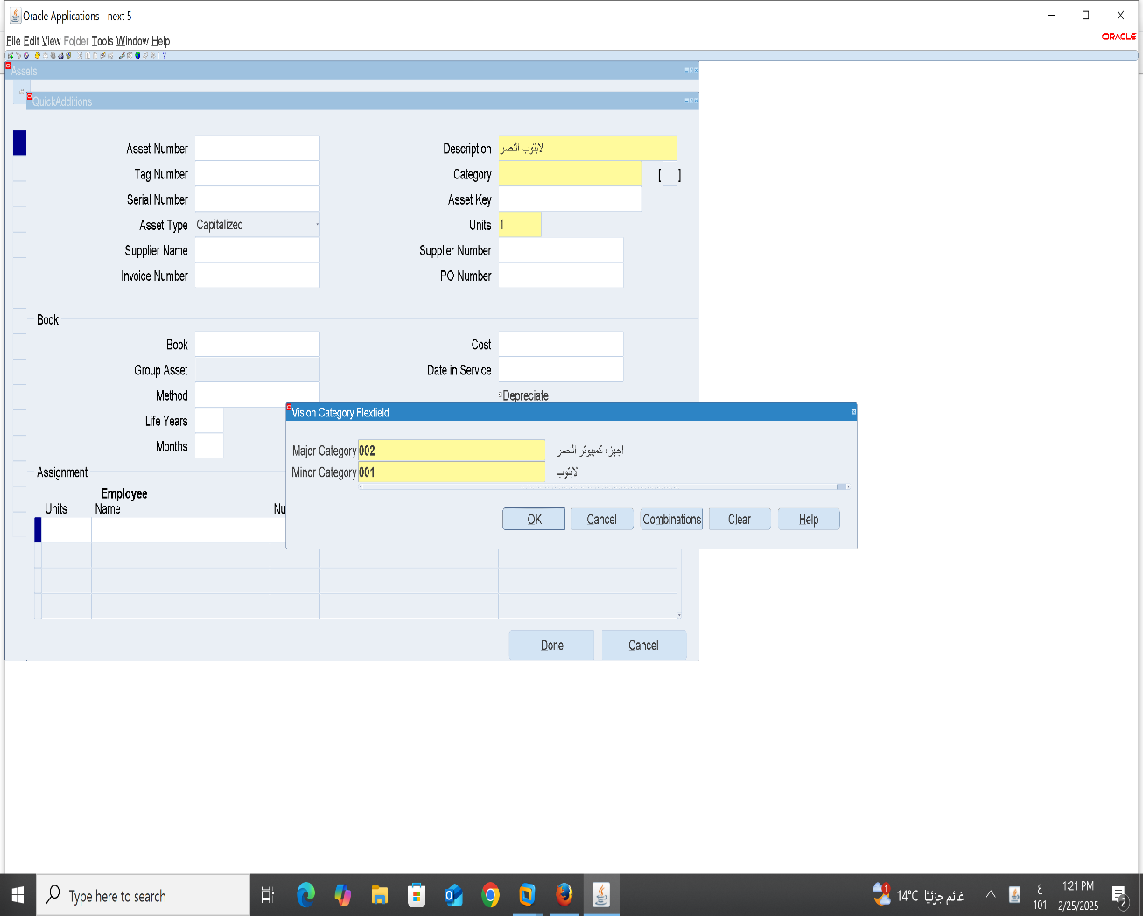
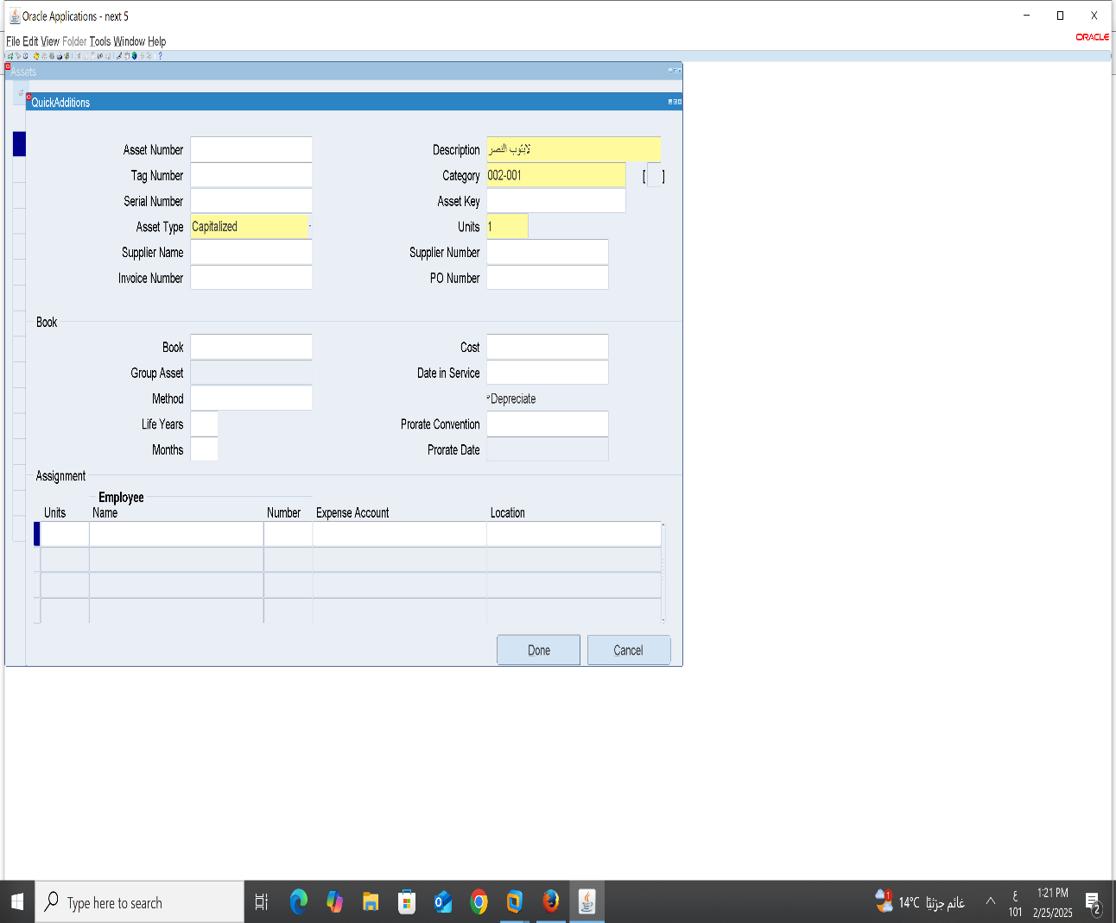
1-Description: 2-Category 3-Units

Slide 34
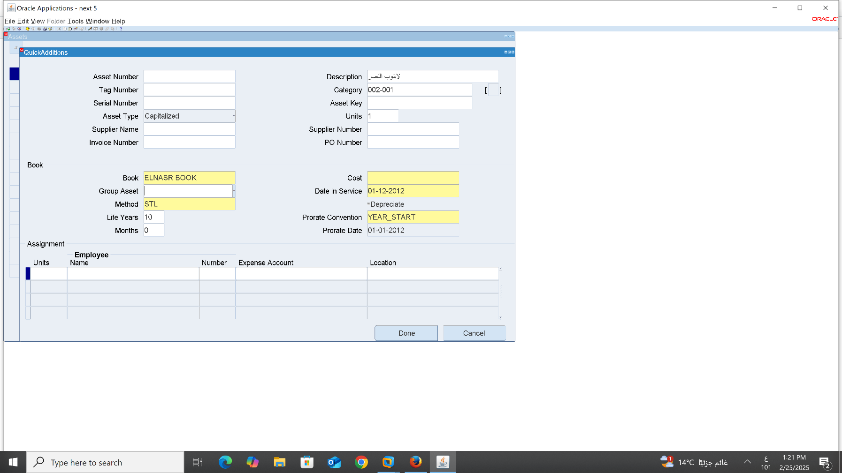
4-Book 5-Method-life yeard-Months 6- Cost-Date in service-prorate convention-prorate date

Slide 35
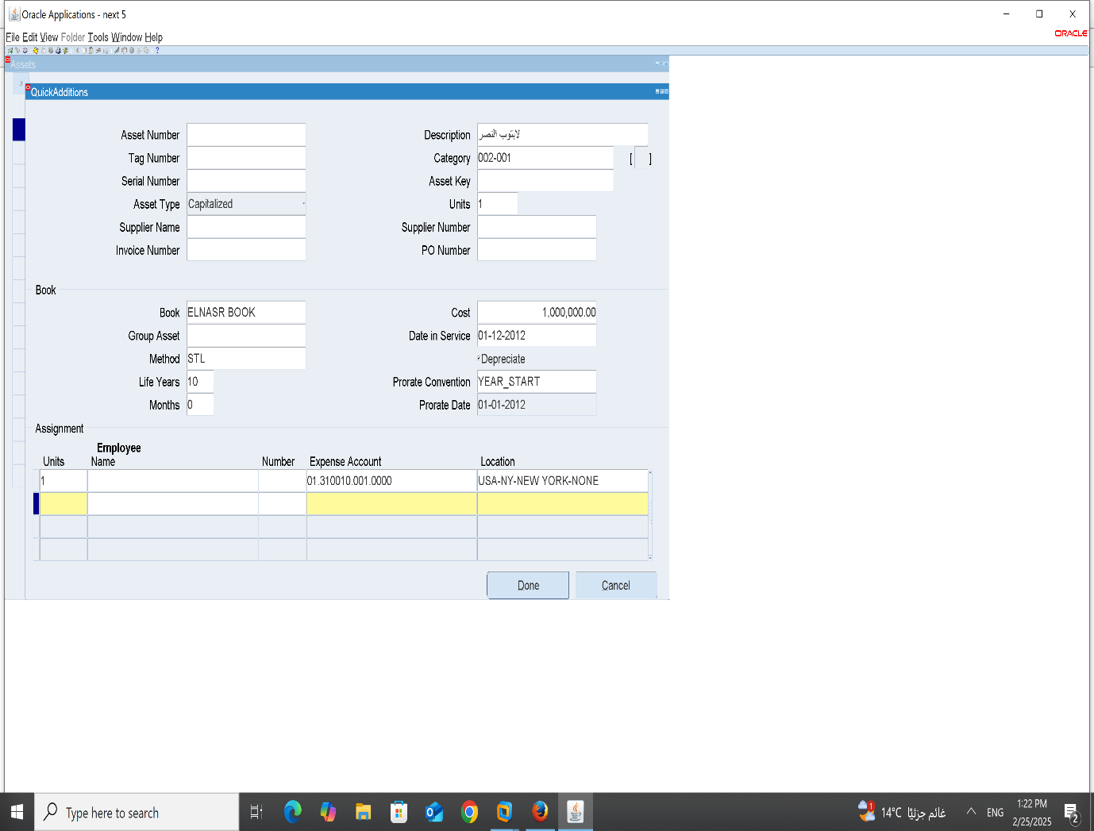

7-units change –Expense Account-Location: 8-Done

Slide 36
5 Mass Addition 6 CIP Assets Additions
YAHYA KHALED

Slide 37

Mass Addition - Step 1

Slide 38

Mass Addition - Step 2

Slide 39

Mass Addition - Step 3

Slide 40

Mass Addition - Step 4

Slide 41

Mass Addition - Step 5

Slide 42

CIP Assets Addition - Step 1

Slide 43

CIP Assets Addition - Step 2

Slide 44

CIP Assets Addition - Step 3

Slide 45

CIP Assets Addition - Step 4

Slide 46
Name : Silvia Hany Abdelmasseh
7- ASSET MASS ADDITION 8- ASSET MASS TRANSACTIONS

Slide 47

7- Asset Mass Addition from Asset – Asset Workbench – find the book you created and this screen will be shown

Slide 48

Manual edit from Machine to Vehicle. we can edit both category and description.

Slide 49

After editing

Slide 50


Editing number of units from 1 to 2

Slide 51

After editing we could add a second unit

Slide 52


Repeating the previous step by editing units and putting -1

Slide 53

Changing the cost of the asset by changing it from current cost

Slide 54

Editing location

Slide 55

After changing unit number 2

Slide 56

8- Asset Mass Transaction from Mass Transactions – Reclassifications

Slide 57

After editing

Slide 58
Name:Yousef Mosad
9- Run Depreciations
10-Create Accounting And Transfer To General Ledger

Slide 59

9 Run Depreciations 1- Depreciations 2- Run Depreciations

Slide 60


3-Book 4-Period

Slide 61

5 Run Request

Slide 62

10-Create Accounting And Transfer To General Ledger
1-Create Accounting

Slide 63

2-Name = Create Accounting - Assets

Slide 64

3-Book Type Code =Al nasr 4- repot= summary 5-ok

Slide 65

6- Submit

Slide 66


7-Run Request

Slide 67
End of Fixed Assets Module
Thank you

